Slide 1


Employment Rights
How do they help to “Prepare for Your New Teaching Job”
Why are they Important?

Slide 2
Why Are Employment Rights and Terms and Conditions Important?
They are the framework of your job
They are the key elements that structure your job
They apply to everyone
They ensure fairness and equality in the workplace
They are in statue and UK wide
They protect against exploitation
They were fought for and won by those who came before you
They are a legacy to be defended
They determine what you earn
They determine your future protection
They come with responsibility
Without the unions including the EIS they wouldn’t exist

Slide 3


Pay

Slide 4

It’s Not All About Money!
Why is it important so early in my career?
Who Decides it?
What has it got to do with me other than my pay at the end of the month?
Why is being in the EIS so important for this?
I didn’t take the job on for the pay, I just love the job?
Isn't pay up to the employer?

Slide 5

Pensions

Slide 6

Where You End Up starts When You Begin
I’m too young to think about pensions?
Is it a general scheme?
I have no influence on what's in the pension scheme!
It is money I could spend elsewhere, why should I be in the Teachers Pension Scheme?
What has a trade union got to do with my work pension?

Slide 7

What Are They?
Why Are They Important?
How Do They Help Me?

Slide 8
What are they?
When you hear “SNCT Handbook” this is where your national terms and conditions are:
Scottish Negotiating Committee for Teachers.
SNCT
Pay
Main Duties
Working Year and Working Week
Class Size
Annual Leave
Sickness Allowances and Notification Arrangements
Family Leave
Disciplinary and Grievance Procedures
Other Provisions
LNCT
These determine matters locally
Areas not covered by SNCT
Areas of improvement on SNCT
Local Terms Procedures and Policies
Local Authority based negotiating machinery

Slide 9
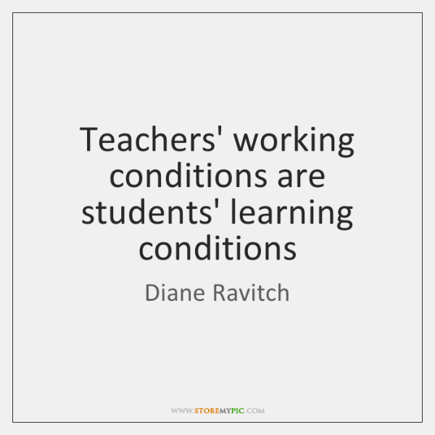

Working Conditions

Slide 10
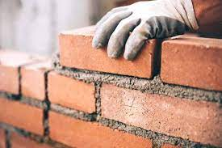
It’s not just bricks and mortar!
The Teaching Profession
Relationships
Respect
Rights

Slide 11

Participate, Protect and Improve

Slide 12
Unions are made up of Members – That’s You!
Your working conditions can be good or bad.
You can determine which, choose wisely.
You can work with others to ensure your workplace is safe.
You can use knowledge of your T’s&C’s to make your workplace better.
You can recognise your role in this.
You can participate.
It’s Your Profession, It’s Your Union, It’s Your Choice

